Slide 1

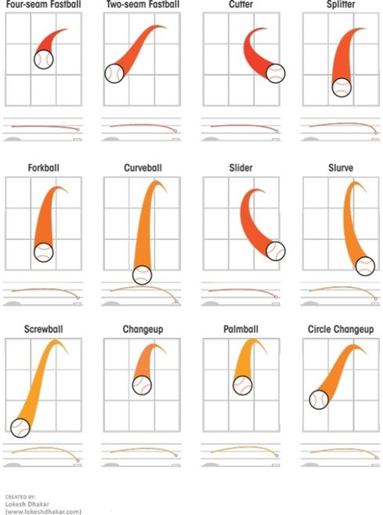


Final Project Presentation: IST 707 - MACHINE LEARNING USING PYBASEBALL
Peter Kucharczuk​
Kishan Polekar
Robert Schnoor

Slide 2
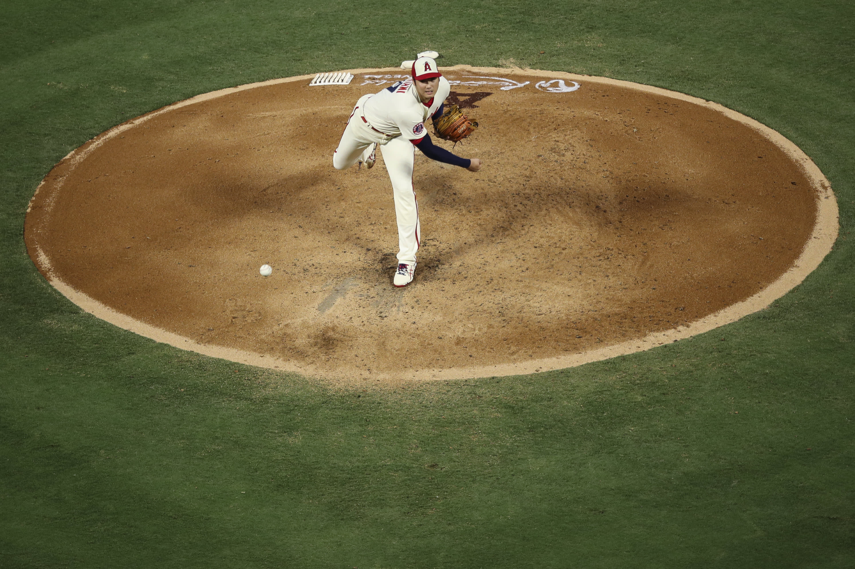
Table of Contents
The Problem
The Data
Exploratory Visualizations
Models Used
Results
Actionable Insights
Limitations/Further Exploration

Slide 3
The Problem
The goal of our project is to predict pitch types using different variables such as the number of balls and strikes, game score, batter handedness, among others.
If the pitch type can be correctly predicted, it will significantly improve the batter's chances.
Teams will be able to use our models to "gameplan" for a given pitcher based on the in-game situation.
We used several models to help with our analysis.

Slide 4
The Data
Our dataset is from the "pybaseball" package in Python. We removed about 60 unnecessary columns which resulted in just over 30 total columns. The dataset contains every pitch from the regular season and postseason.
Our training dataset consists of all regular season data and the test set is all the postseason data.
We identified 14 pitchers to include in our analysis each of whom started at least 2 playoff games for their respective teams.
After filtering the data, the train set has 38,456 rows while the test set has 4,532 rows.

Slide 5

Pitchers Used Must Have Started Two or More Games in the Postseason
Aaron Nola
Zach Wheeler
Ranger Suarez
Nathan Eovaldi
Zac Gallen
Jordan Montgomery
Merrill Kelly
Brandon Pfaadt
Justin Verlander
Framber Valdez
Christian Javier
Spencer Strider
Sonny Gray
Pablo Lopez

Slide 6
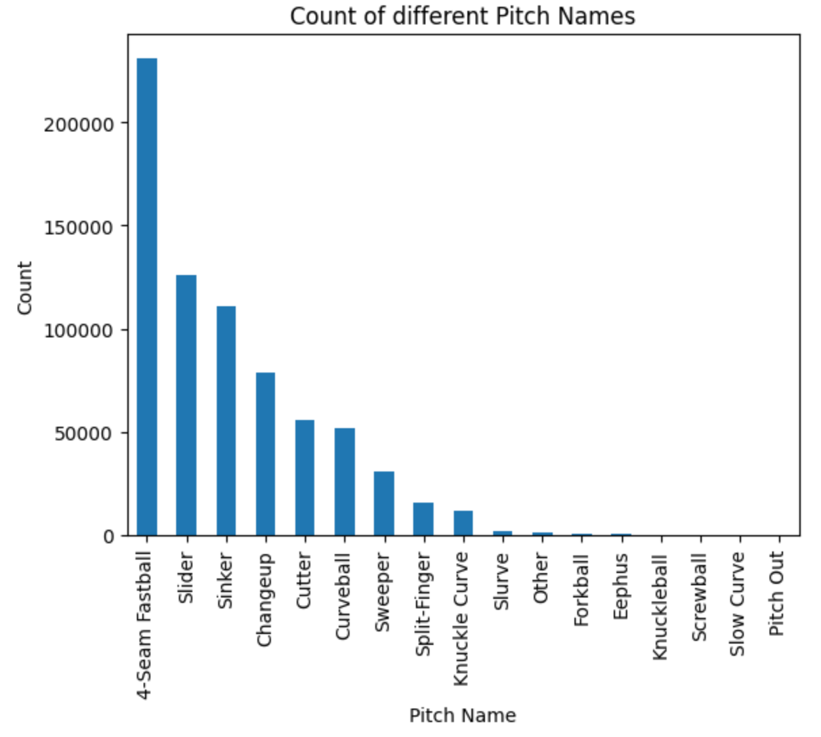
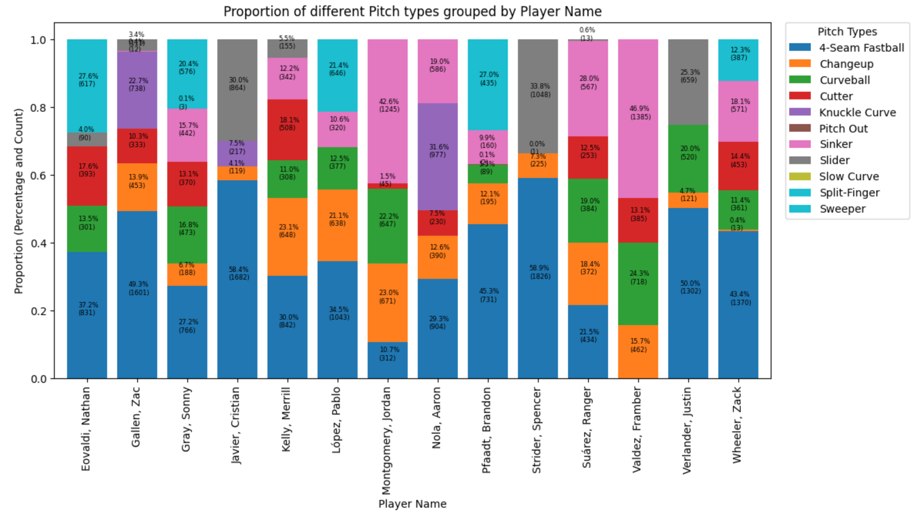
Viewing the Data
There are 17 different pitch types within our dataset. The most common are four-seam fastballs, sliders, sinkers, and changeups.
This graph shows the pitch type breakdown for each individual pitcher. The pitch arsenals vary heavily depending on the pitcher.

Slide 7
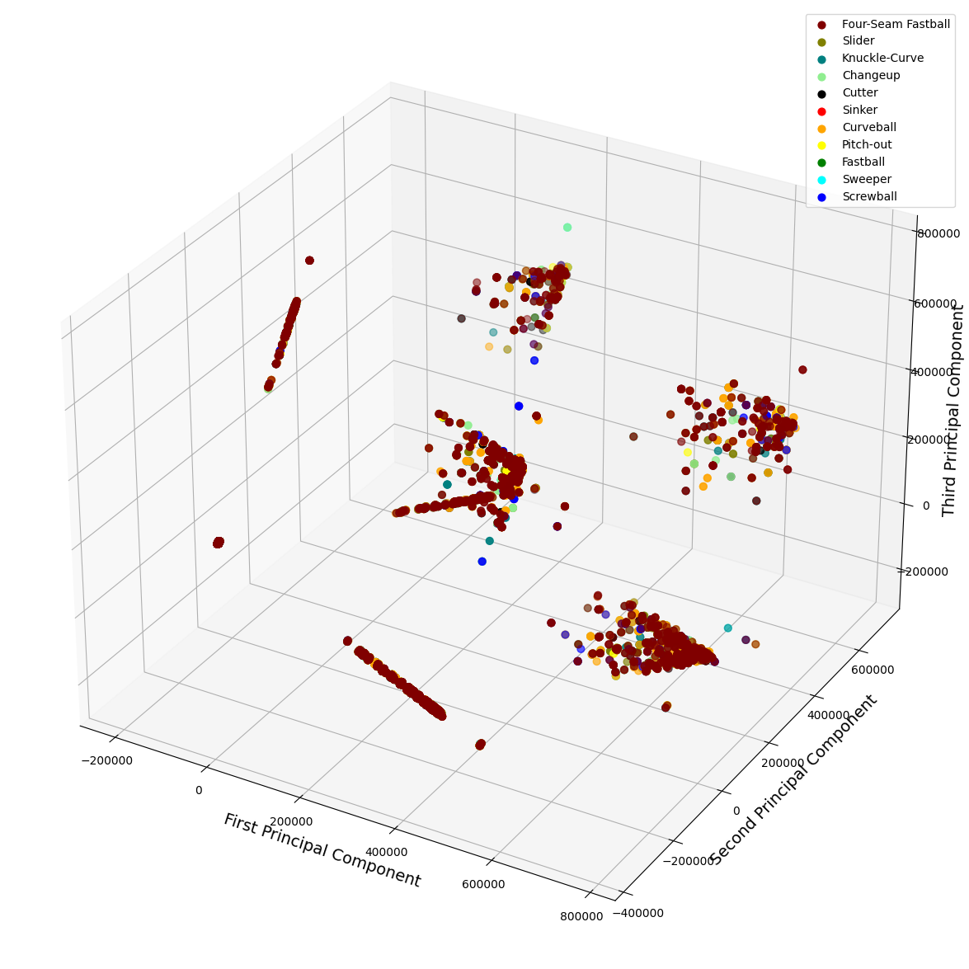
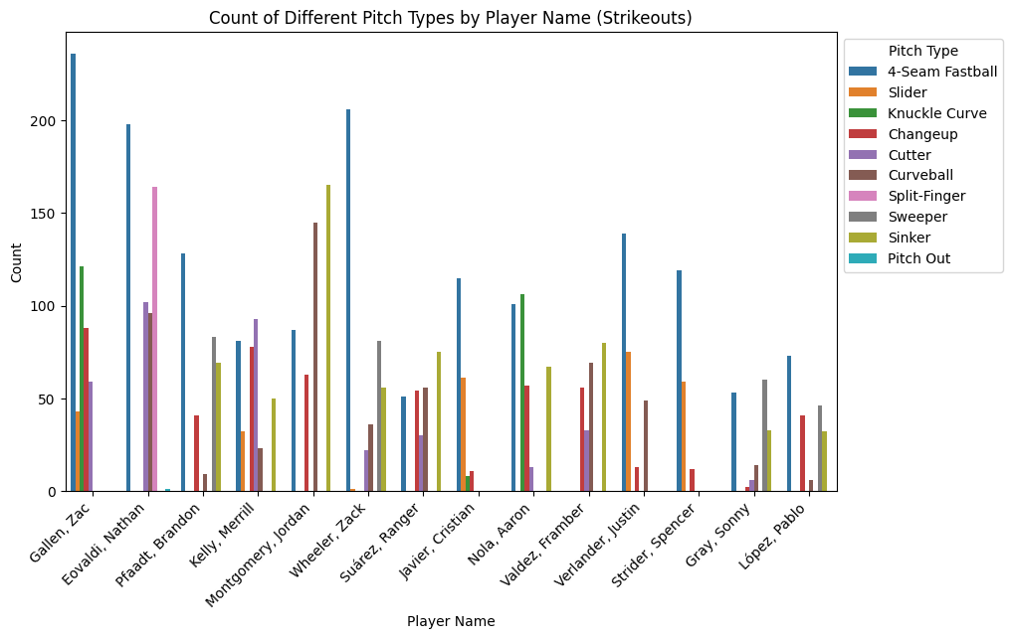
Viewing the Data
This graph shows the count of different pitch types for each pitcher when a strikeout occurred. When there are two strikes, we can expect these pitches to show up in our predictions.
Principal Component Analysis: This helps to understand the distribution of the different pitch types in a reduced dimension.

Slide 8
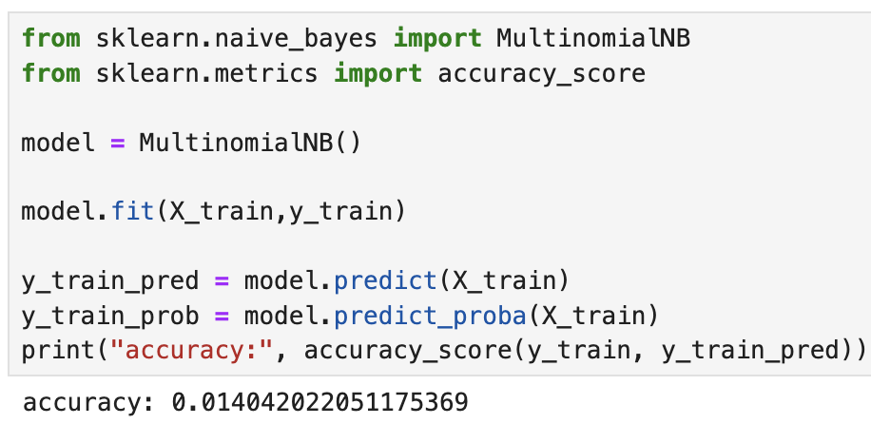
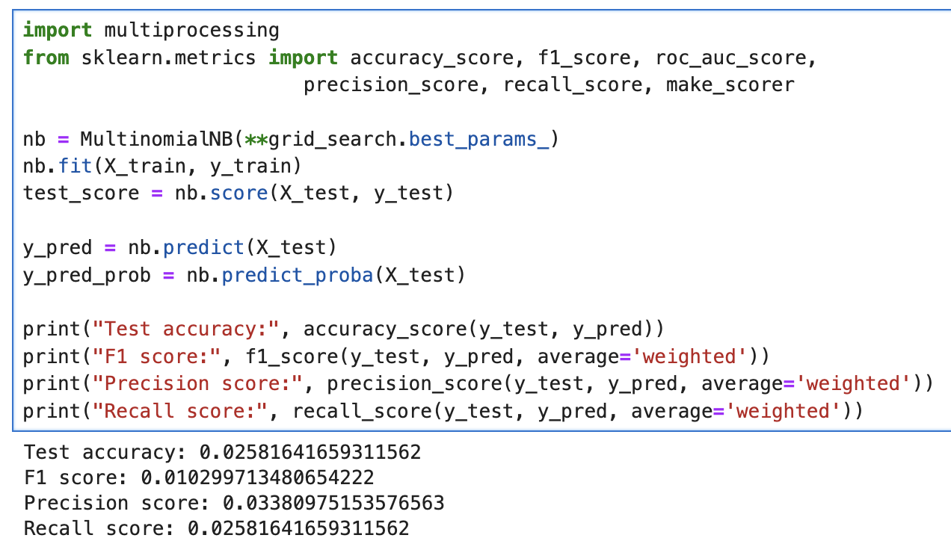
MultinomialNaïve Bayes

Slide 9
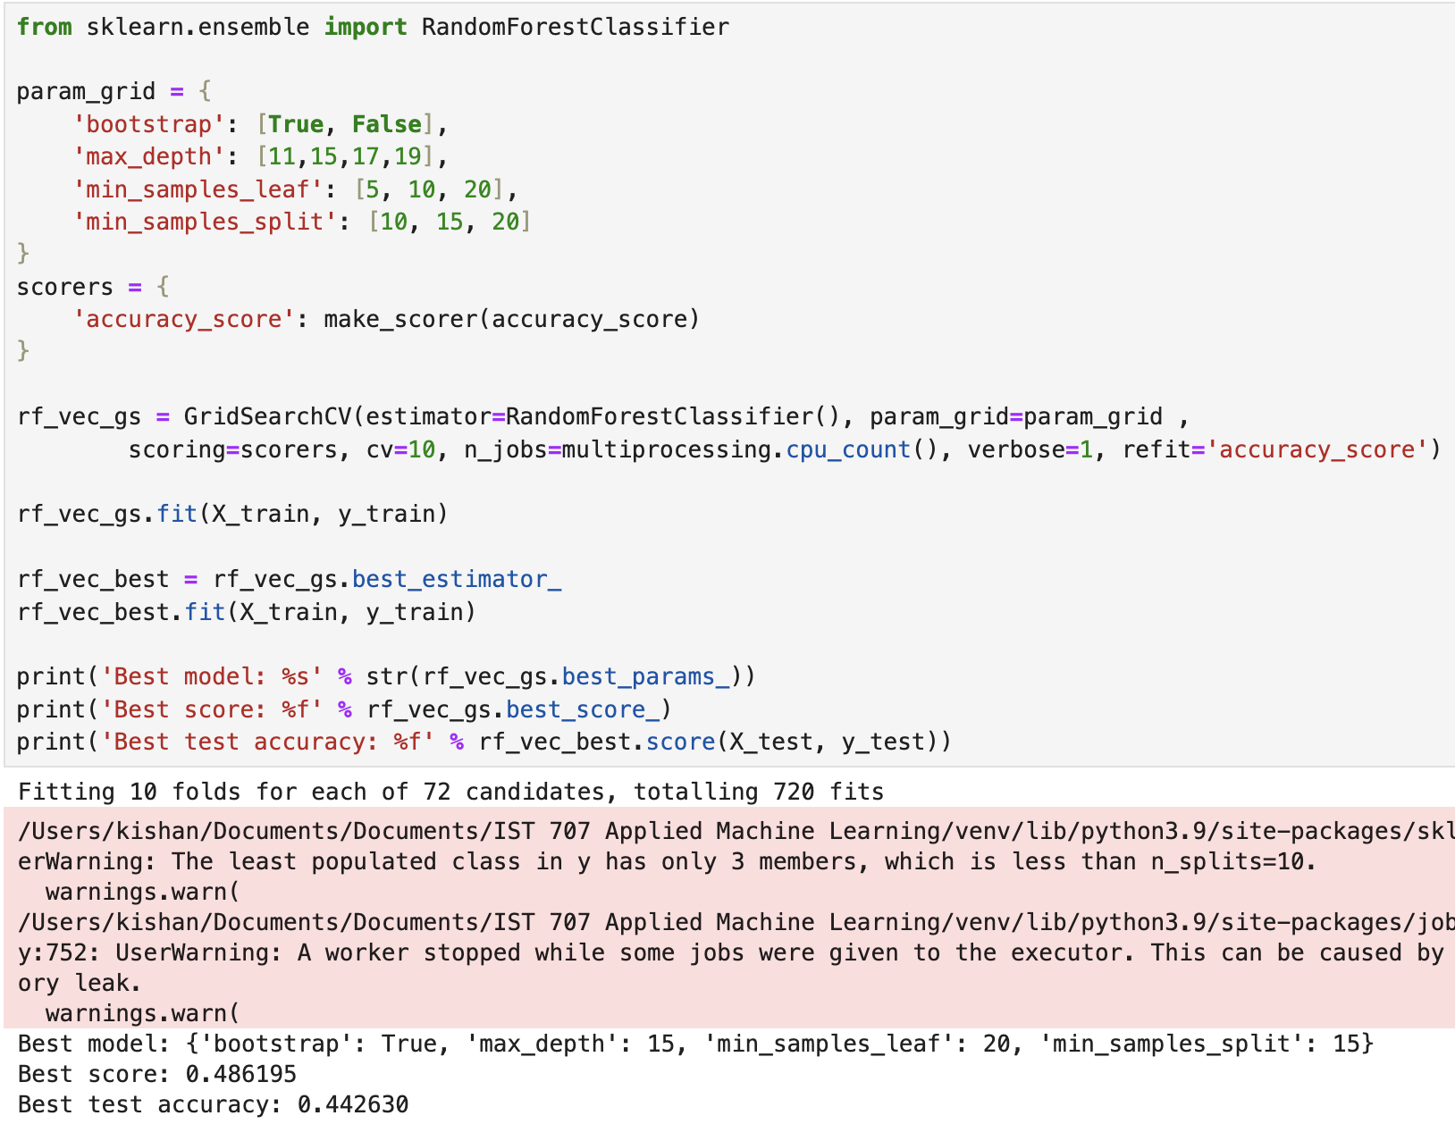
Random Forest

Slide 10
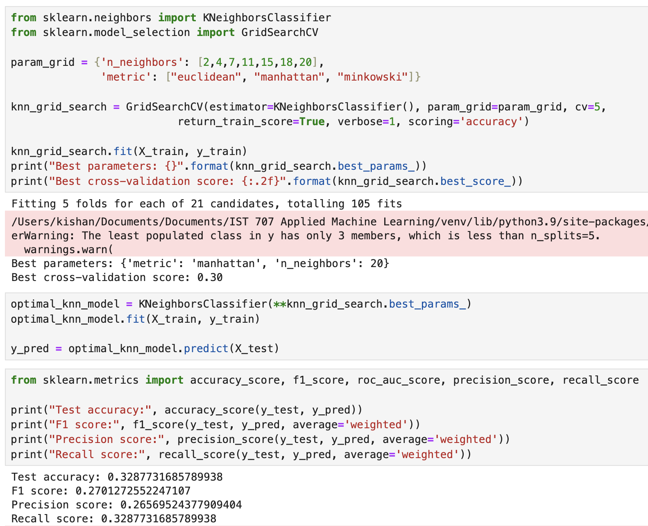
K Neighbors

Slide 11
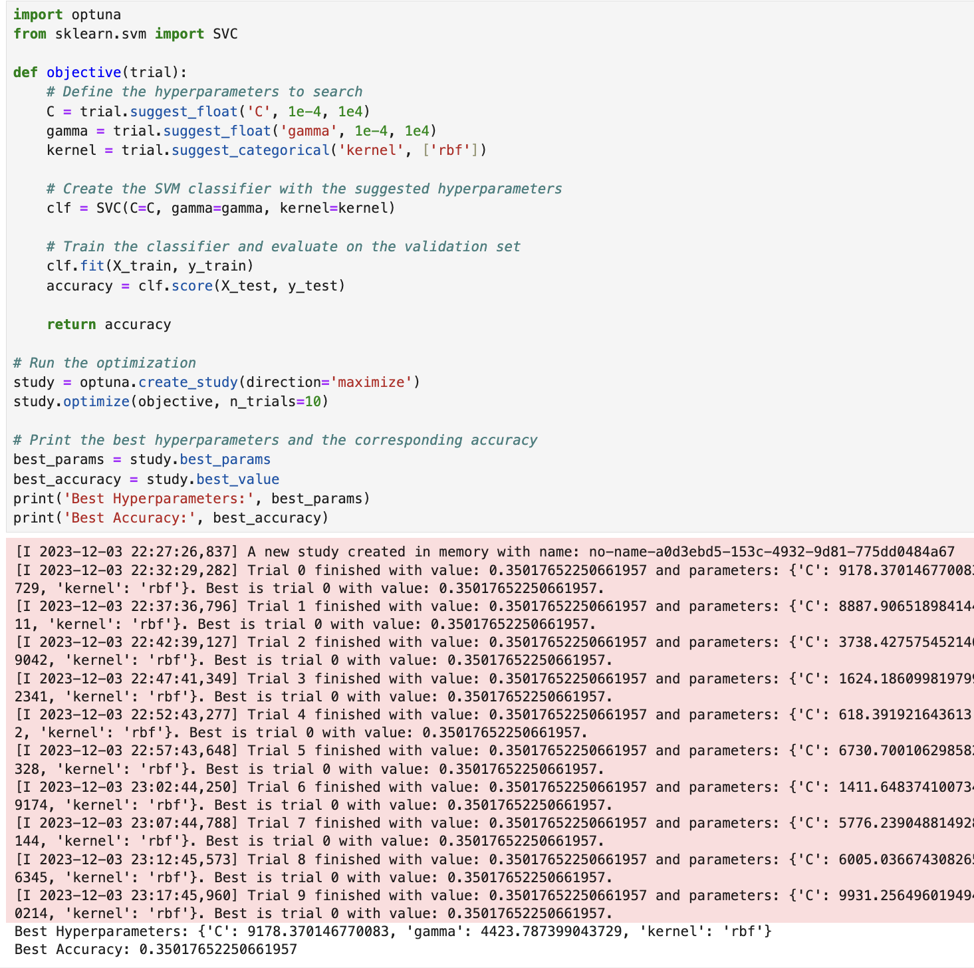
Support Vector Machine

Slide 12
Results for Individual Pitchers
Additionally, we completed the results for each pitcher individually
The three pitchers with the best results were Aaron Nola, Zac Gallen, and Jordan Montgomery
Multinominal Naïve Bayes: .255 accuracy, .288 test accuracy .288 recall score
Random Forest: .334 best score and .328 best test accuracy
K Neighbors: Best cross-validation .19

Slide 13
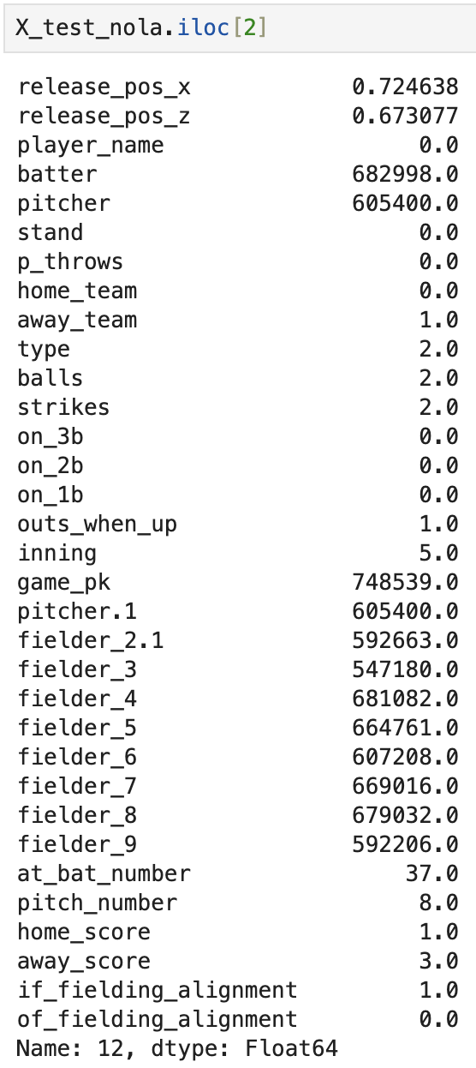
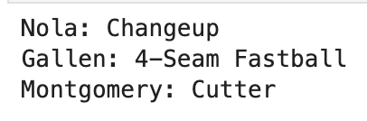
Actionable Insights

Slide 14
Limitations/Further Exploration
There are many outside factors that are not definable that affect a pitcher’s decision.
Considering the amount of variability within this space and the number of different pitches for each pitcher, attaining high accuracy levels is very challenging.
Our test set consists of postseason data which could potentially affect the pitcher’s game plan considering the importance of the game.
With more time, we could've better analyzed each in-game situation and conclude which ones are easiest to predict. Those results would be useful for the teams and players.

